Slide 1
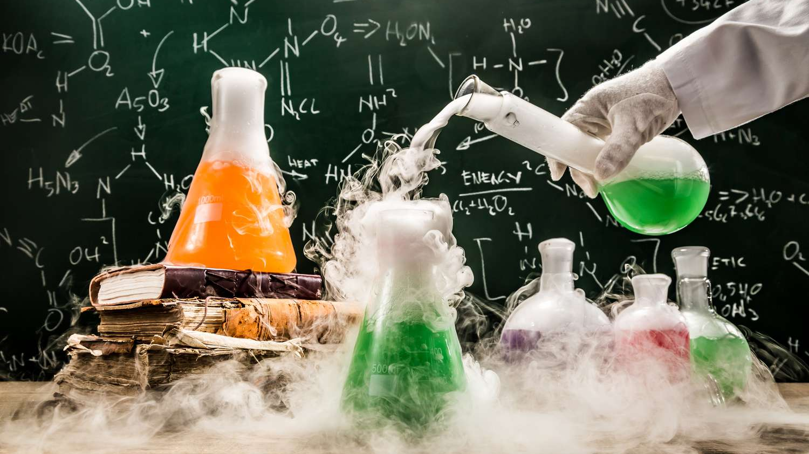
A-Level Chemistry!
Year 12 – September 2023

Slide 2
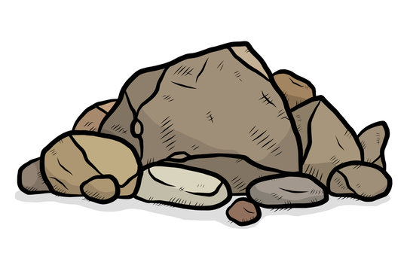
Biology
Astronomy
Medicine
Chemistry:
The central science
Engineering
Physics
Geology

Slide 3
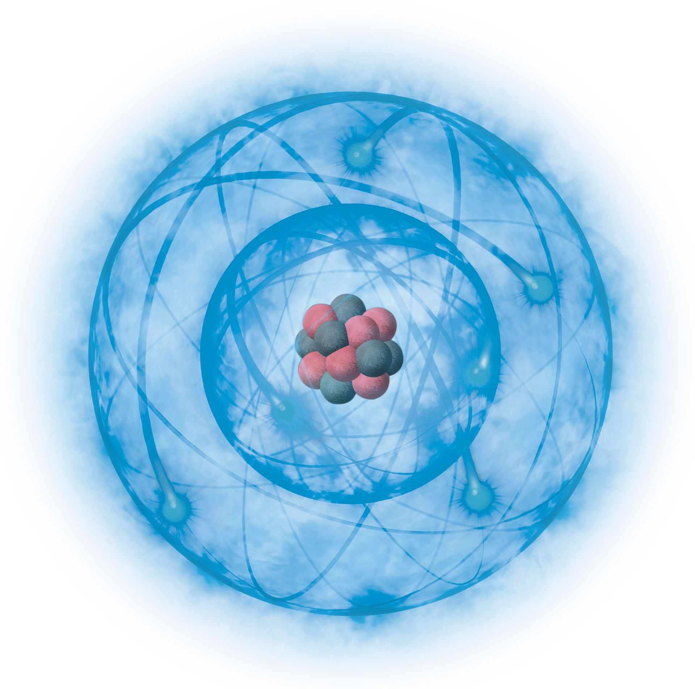
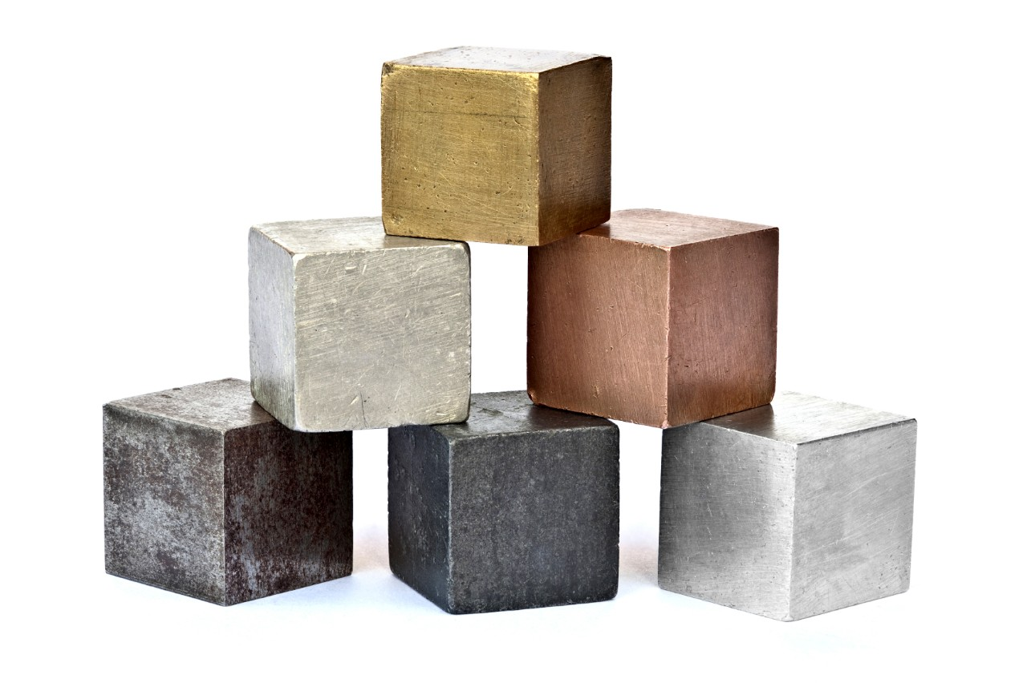
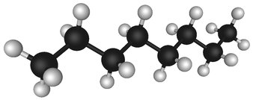
What is chemistry?
Physical
Inorganic
Organic
Atomic structure
Ionic bonding
Covalent bonding
Metallic bonding
The periodic table
Alkaline earth metals (Group 2)
Transition metals
Halogens (Group 7)
Alkanes and alkenes
Polymers
Alcohols, carboxylic acids and amino acids

Slide 4
OCR Chemistry A: Course structure
12
13
Module 1: Practical Skills
Module 1: Practical Skills
Module 2: Foundations in chemistry
Atoms, compounds, molecules and equations; Amount of substance; Acid-base and redox reactions; electrons bonding and structure
Module 5: Physical chemistry and transition elements
Reaction rates and equilibrium; pH and buffers; Enthalphy, entropy and free energy; redox and electrode potentials; Transition elements
Module 3: Periodic table and energy
The periodic table and periodicity; Group 2 and the halogens; Qualitative analysis; Enthalpy changes; Reaction rates and equilibrium
Module 6: Organic Chemistry and Analysis
Aromatic compounds; carbonyls and carboxylic acids; amines, amino acids and polymers; organic synthesis; chromatography and spectroscopy
Module 4: Core organic chemistry
Basic concepts; Hydrocarbons; Alcohols and haloalkanes; Organic synthesis; Analytical techniques

Slide 5
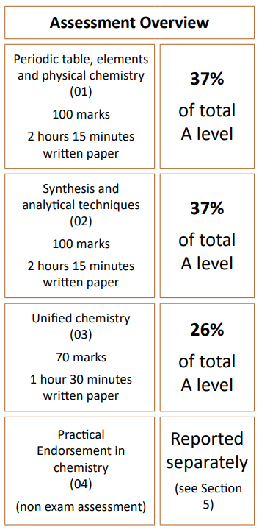
How is it assessed

Slide 6
Practical Endorsement
Assessed throughout years 12 and 13 in set practicals (known as Practical Activity Groups (PAGs))
Assessed by your teacher – OCR run school inspections to ensure these are being carried out properly
In each practical, you will be assessed on set criteria, these will be made clear to you in advance
You need to pass each criteria at least once in order to pass your practical endorsement

Slide 7
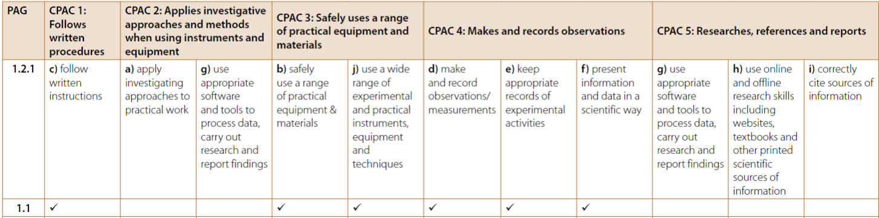
Criteria

Slide 8
Practical books
You will receive a practical book each year which contains all the information for the practicals we will do and is where you should complete any work relating to these practicals
It is essential that you do not lose this as it is a record for gaining the practical endorsement at the end of the course
In general, we will take these in at the end of the lesson to keep them safe, however there will be occasions where you need to do homework in them and must ensure they are not lost

Slide 9
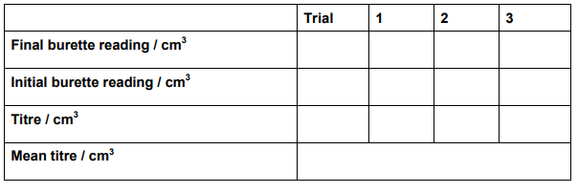
Some tips

Slide 10
How is A level different to GCSE
GCSE
A-Level
University
Highly teacher led
Limited student independence
“Spoon Feeding”
Collaborative between teacher and student
Independent and personal responsibility essential
Lecture based
Limited contact hours
Students take charge of vast majority of their own learning

Slide 11
…so what does that mean?
The expectations that I have of you are significantly higher than at GCSE:
You will have 5 hours of lessons in chemistry per week, I would expect that you are completing the same amount of time outside of lessons on your studies
Outside of lessons, your time should be split on a mixture of teacher set homework, continual refreshing / revision of content and extra curricula reading– I can’t stress enough how much this will help you later in the course
Where you are finding content more challenging, you need to make sure you are taking responsibility for improving – your teachers will be more than happy to help and give additional support, but you need to take ownership and reach out

Slide 12
Mapping grades at Edexcel GCSE and OCR A Level Chemistry
Based on our recent date data, with some exceptions, 7-6/776/766/666/66 students at GCSE get a C or below at a-level chemistry and 77/777 and above students get a grade A*-C. Double/triple science makes no difference. Think about what you need to do to achieve your goals!
GCSE
9
8
7
6
A Level Grade
A*
A
B
C
D
E
A level is WAY more rigorous than GCSE.
You will be spending far more time on it than at GCSE and therefore you need to have a much firmer understanding of the concepts to get the same number of marks.

Slide 13
Things you receive today
Transition work
Things to receive at a later date:
Text Book
Practical book (to hand back in)
Practical handbook
Maths handbook
Specification
Data tables
Aptitudes of a sixth form chemist

Slide 14
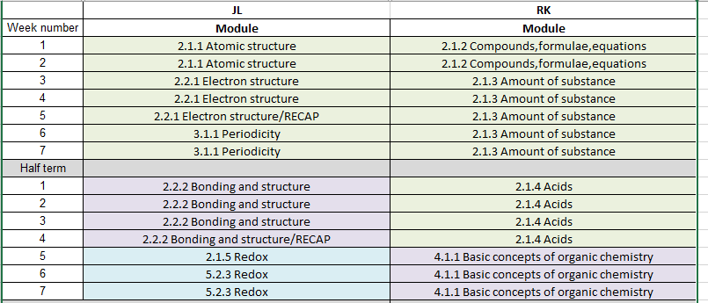
Structure (rough!) of first term

Slide 15
Any questions

