Slide 1
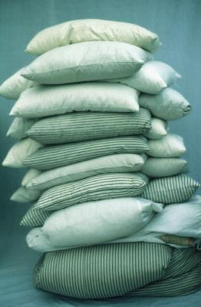
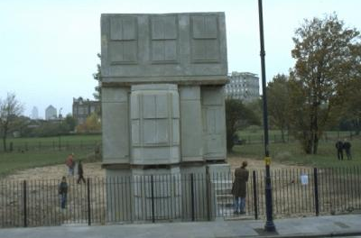
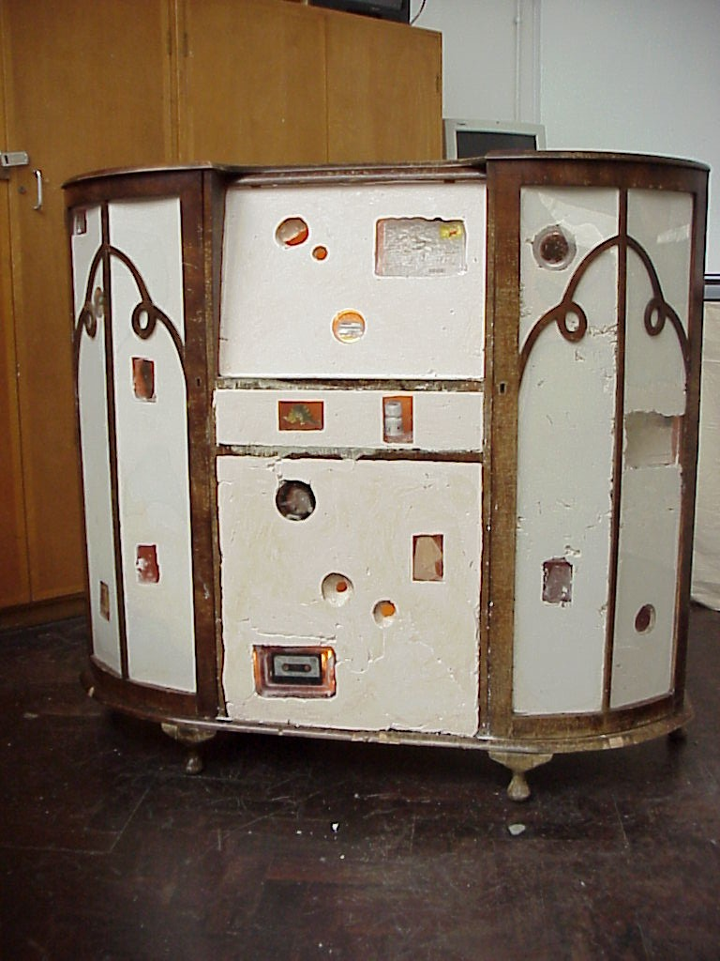
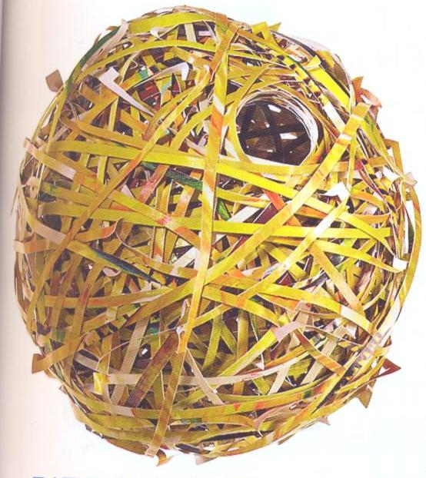
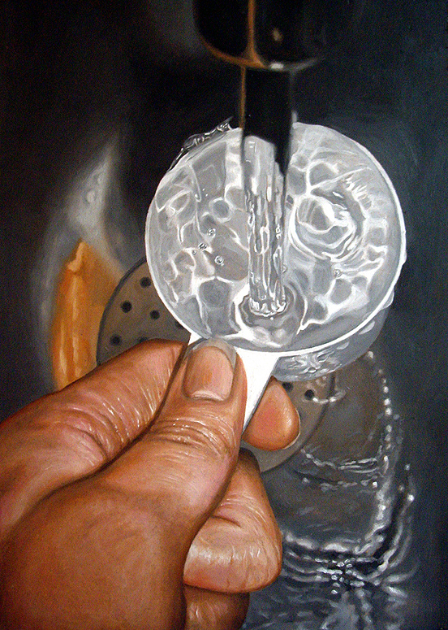
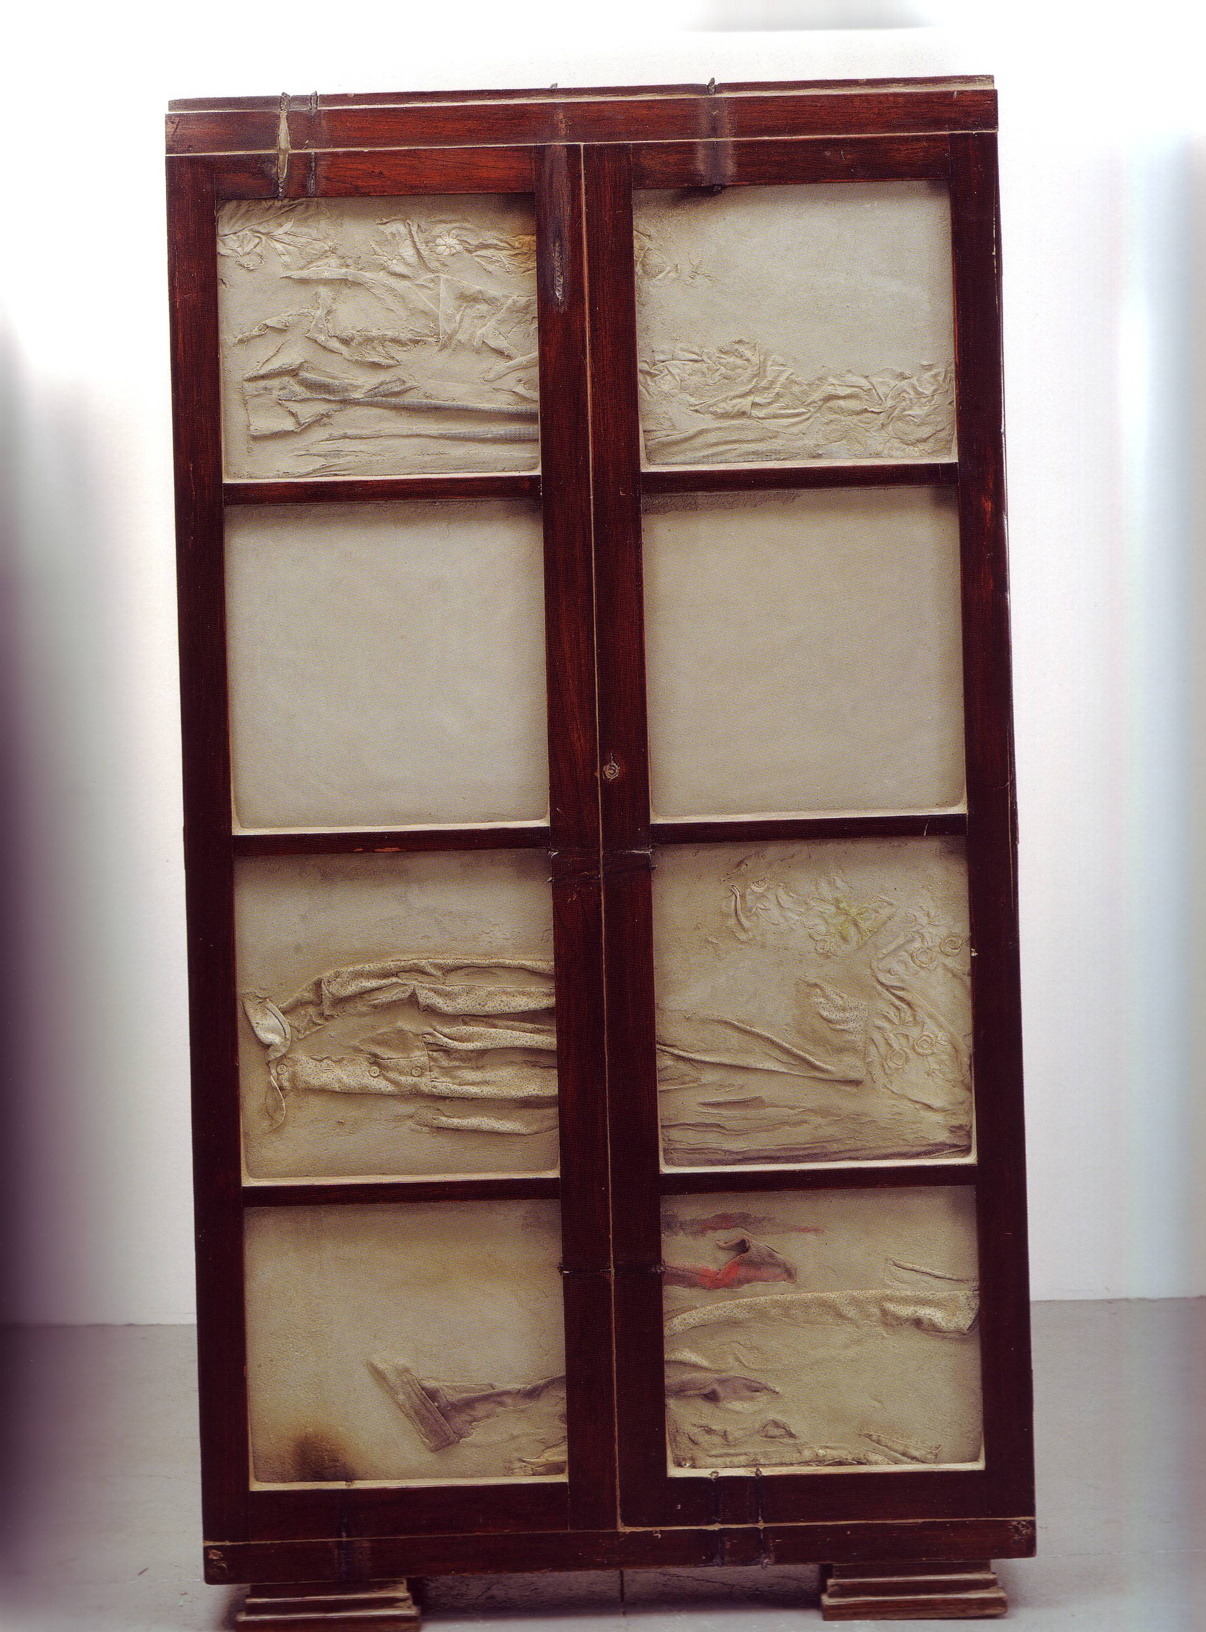
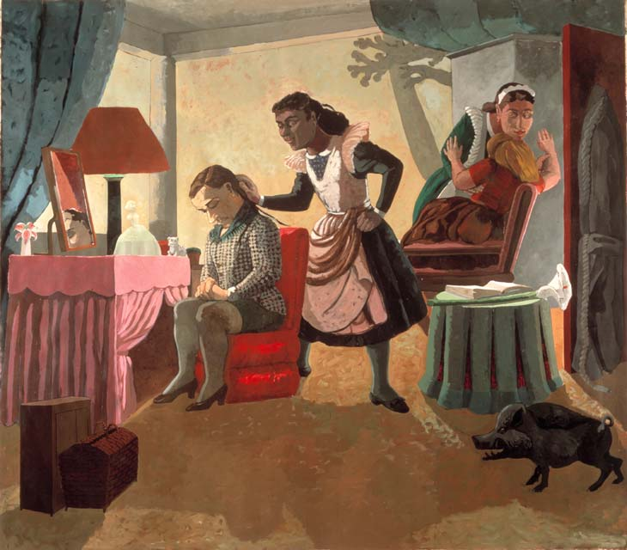
Year 11-12 Summer Work
Brief: You are to develop your own project in any media on the theme of ‘home’. We will provide you with a range of starting points and lists of things you can draw, paint, make and photograph. All elements of the project are compulsory but it will be up to you as to the direction you want to take it towards the end of the project. Remember to include research into relevant artists, you can copy or interpret their work to help you with your ideas. Use artists to help you to solve problems. Have fun and play!
Artists to inspire:
Mona Hatoum
Rachel Whiteread
Cornelia Parker
Cindy Sherman
Andy Goldsworthy
Anthony Gormley
Doris Salcedo
Paula Rego
Tracy Emin
Marcel DuChamp
Luc Tuymans
Louise Bourgeois
Patrick Caulfield
Robert Gober
Sophie Calle
Barbara Hepworth
Sarah Lucas
Richard Wentworth
Thomas Demand
Pierre Bonnard
Bill Woodrow
Richard Deacon
Tony Cragg
Edward Hopper
Michael Landy
Alison and Peter Smithson
Vija Celmans
Toba khedoori
Home…

Slide 2
Weeks 1 &2
Drawing challenge - drawing from any of the starting points on the Home ppt. or your own ideas. Vary the scales, materials, viewpoints, work on other surfaces such as envelopes, inside cereal packets pages from old/out of date books (with the agreement of parents!) Complete at least 4 double pages of drawing, your sketchbooks should be A4 so this should be 4 A3 pages of drawing. If you do not have a sketchbook at home you can either order one from cass Arts, use paper from old sketchbooks or make your own (this is very easy to do and there are lots of tutorials online if you want to make something more complicated).
Starting points: Things to draw
cutlery
piles of clothes
washing up in the sink
stacks of books
plants
the table after you have eaten
People reading, watching TV, playing games
Corners of rooms
Windows
things from a drawer
Lamps
Shelves

Slide 3
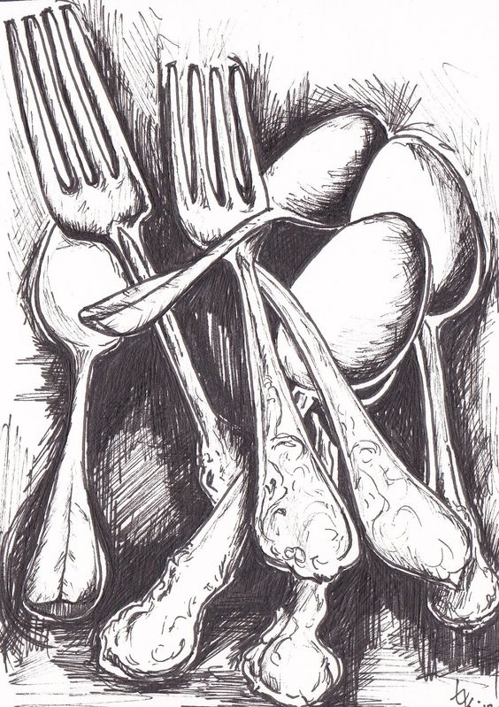
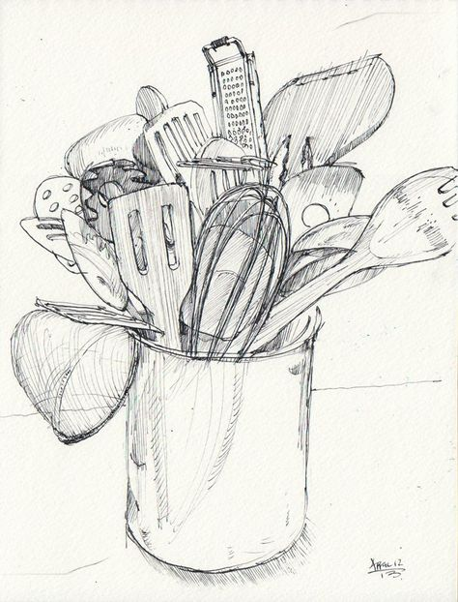
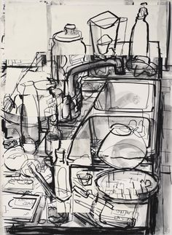
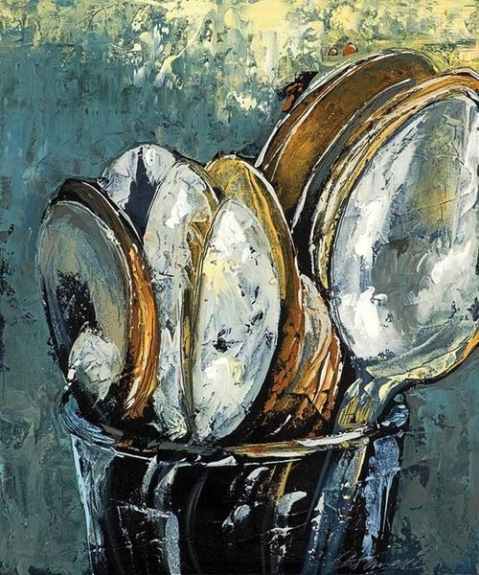
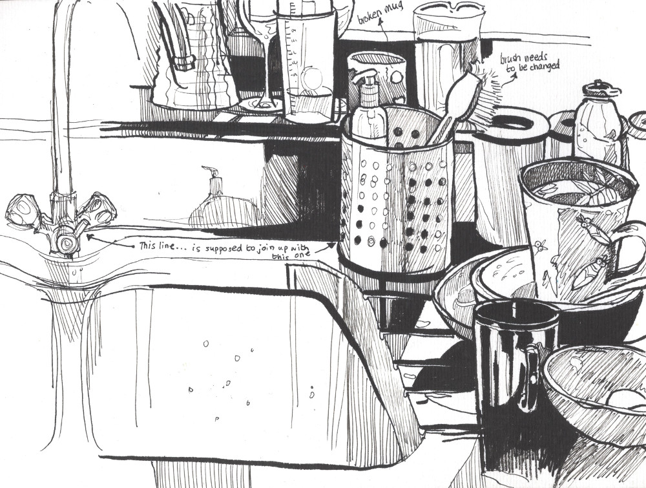
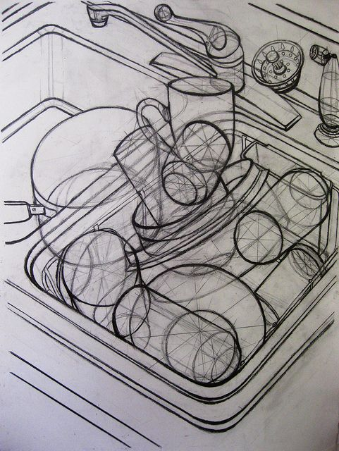
Open drawers, find busy corners, explore a variety of view points and heights. Use pencils, charcoal, ink, create surfaces and grounds with other paper such as envelopes, tape, any household paint you may have.

Slide 4
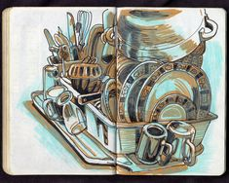

Slide 5
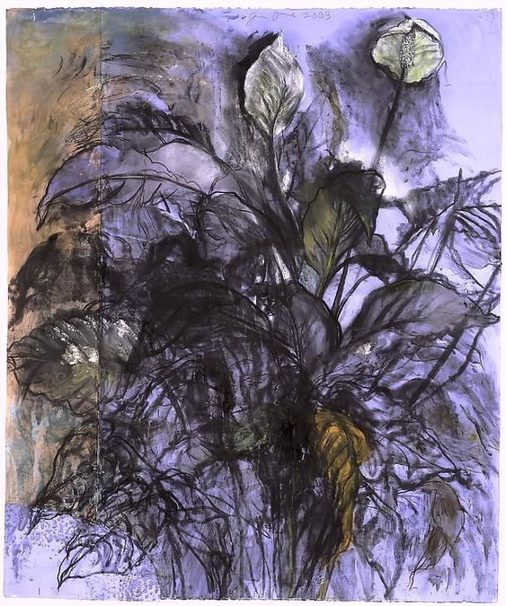
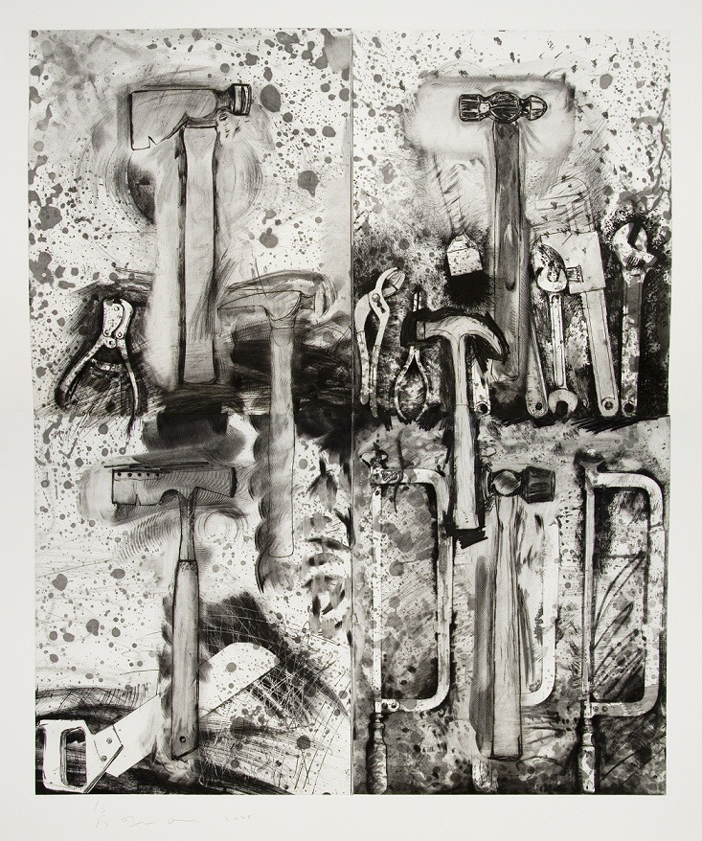
Jim Dine, American. born 1934

Slide 6
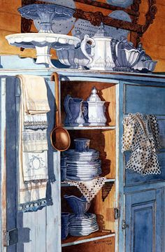
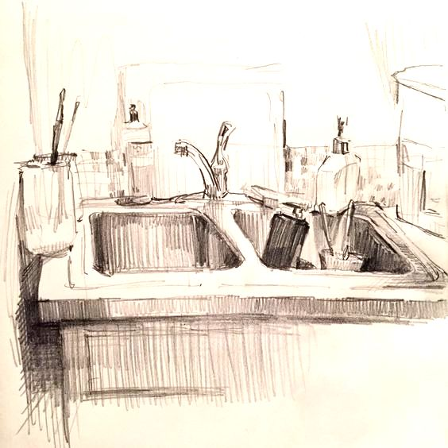
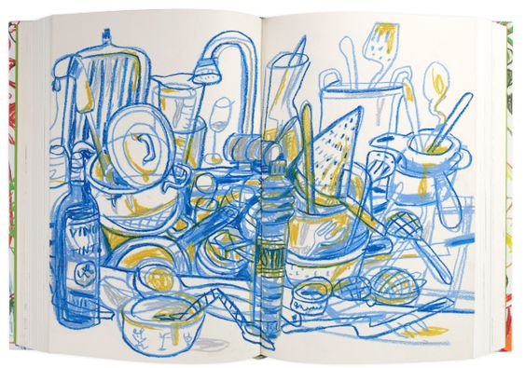
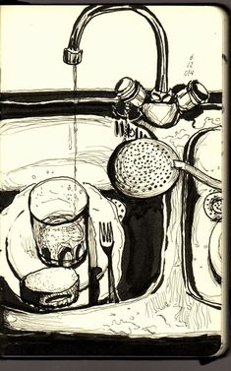
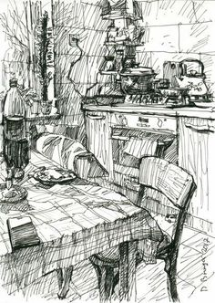
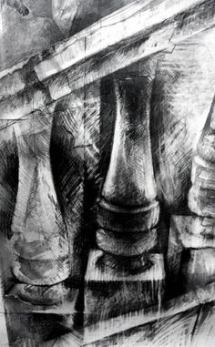

Slide 7
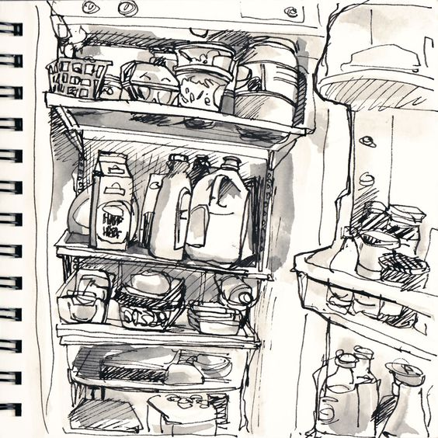
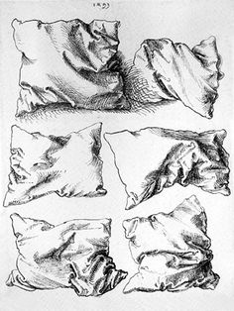
Piles, stacks, pen & wash

Slide 8
^{Weeks 3&4}
^{Photography challenge.}
Save digitally, and present on a powerpoint (unless you have a printer and can print the pictures out) Use the best phone camera you have available to you, or a digital DLSR camera (like we have in school).
Take at least 40 (high quality) photos exploring one theme from the home brief or the inspiration here. You may want or need to take more than 40.
Identify your best 8 photographs. Evaluate and re-shoot your best idea to come to a series of 3, well composed, well-lit, focused final photos.
Remember to show everything you learnt about composition from GCSE. Draw or paint all of your final photographs these can be any size bigger than A5.

Slide 9
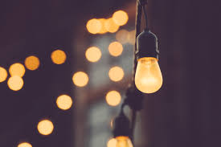
Tips
Use as much natural lighting as possible
Do not use the flash. It will bleach and flatten your photo.
Turn on the composition grid and use the “rule of thirds”.
For still life, experiment with both dark dramatic and moody backgrounds and bright, light filled backgrounds
Always frame your shot very carefully. Consider it a painting and look at and control what is touching the edges of the frame.
Declutter and control backgrounds.
ALWAYS focus your photo. Touch the screen and wait for it to focus before taking the shot.
In photography, the effect of having focal point in sharp focus and the background blurred is called the “depth of field”. On a phone, you can create this by focussing your camera and tapping the screen on a close up focal point within the image. Have a play with this.
There are also lots of basic tutorials on how to take high quality photographs with your phone on you tube.

Slide 10
Environments and Spaces

Slide 11
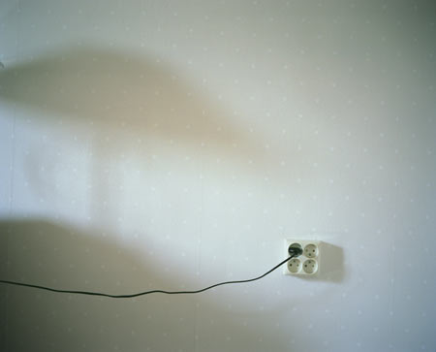
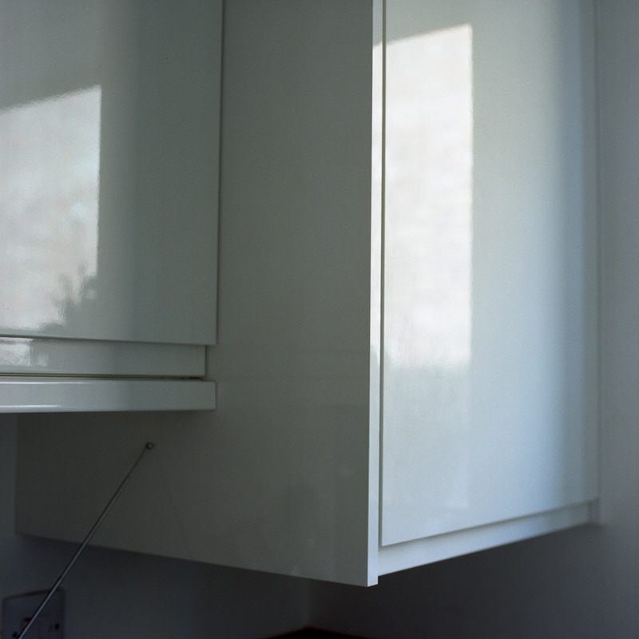
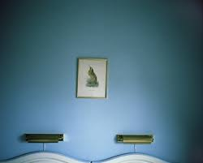
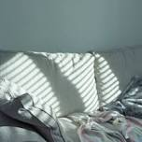
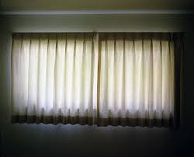
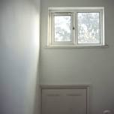
Explore your home through photography. Look at how the light enters the space at different times of the day. Create a series of beautiful subtle photographs that could lead into painting?
Lottie Howard
Grant Ernhart

Slide 12
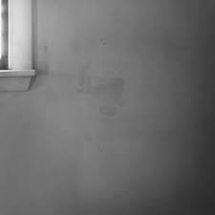
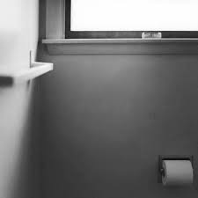
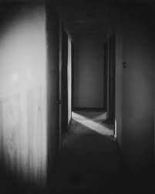
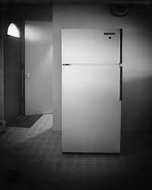
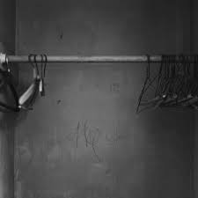
Adam Holtzman

Slide 13
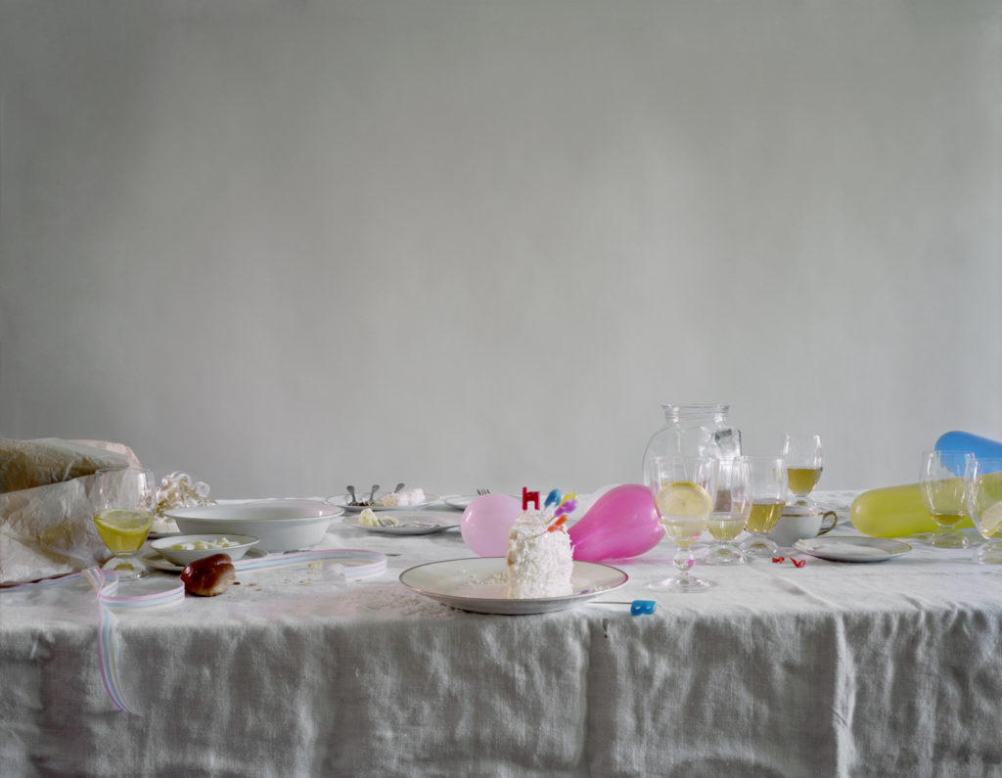
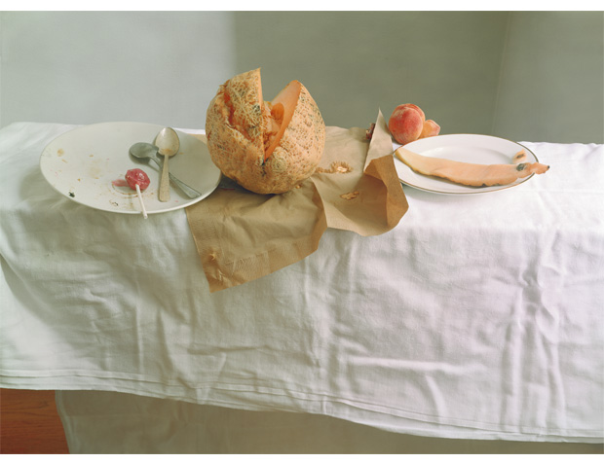
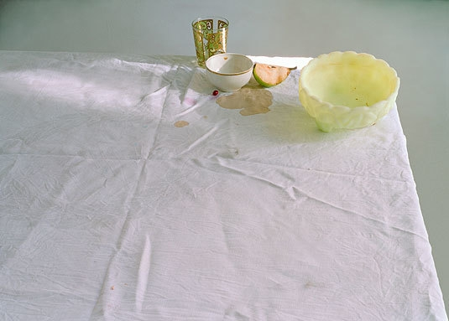
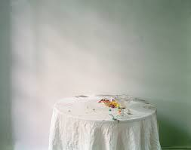
Photograph your dinner table after you have eaten, or set a scene as if you are photographing what is left over after a party or special occasion.
Laura Letinsky

Slide 14
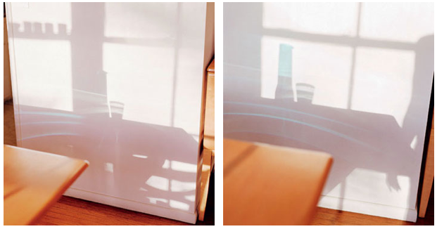
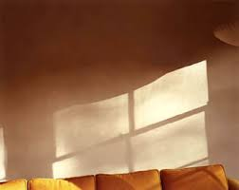
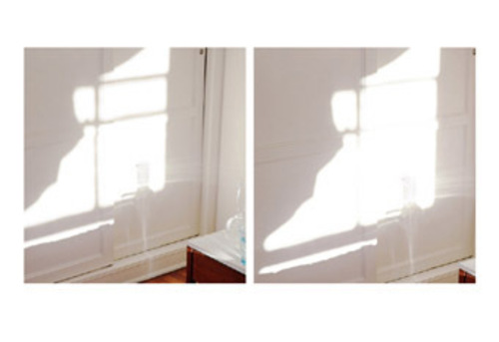
Uta Barth – light and shadows
“Uta Barth’s latest series of photographs, ‘Sundial’ (2007), describes the effects of light as it shines into her home at different times of the day and at different times of the year. Many of the images are cool and replenishing scenes of sunny clarity, and, arriving somewhat harried at the gallery to see them, I wondered whether anyone, nowadays, can have the time to enjoy such moments of placid repose.
Others in the series, however, evoke the progress of obscure, searing psycho-dramas, as though storm clouds of bad karma were passing through the living-room, and these, I suppose, provide part of the answer: while we all may be able to spare at least a few moments, we can never sufficiently put aside our cares really to wallow in that tranquillity.” Frieze Magazine

Slide 15
“Ground” 1997
I was taking a painting class in undergraduate school and wanted to render certain spatial configurations and to study the light of these imagined scenes. I did not have the skill to paint the images directly, so I started to make photographs to work from. But repeatedly I found the photographs that I thought to be the disposable source materials much more interesting and more engaging than the paintings and drawings I made from them. I also found that the process of making photographs forced me to learn how to truly see, to see the light, to study how things in an image relate to the edge, how to crop and frame the most mundane and incidental subject matter into a compelling image. I remember a teacher talking about the difference of making an engaging photograph of an ordinary thing versus making an ordinary photograph of an engaging thing. So early on I started pointing my camera at the incidental, the ordinary and the insignificant information that surrounds us but that we pass by without noticing everyday.
Please read the full interview here.
https://bombmagazine.org/articles/light-looking-uta-barth/

Slide 16
The centrepiece of Uta Barth’s latest solo show is a photo series depicting a continually morphing strip of light beneath her living-room curtains, a preposterously simple conceit which nevertheless yields complex optical illusions. As this diaphanous sliver shifts course over an afternoon, it variously resembles a snake, a line on an EKG or a trail of cigarette smoke, all the while transforming the space between the camera, the curtain and the window into an ambiguous territory where volumes flatten or swell, and light can pass for white paint. Two glimpses of Barth’s hand arranging the curtain folds remind us of her agency, but it’s nature’s hand that propels the work’s attractively simple narrative as the sun’s changing position gradually increases the width of the band. At this time of year, as the onset of winter makes Barth’s invitation to contemplate sunlight especially attractive, the work entices us into the pleasures of solitary idleness that are at odds with the pace of everyday urban life. Tanya Bonakar gallery 2011. Newyorkarttours

Slide 17
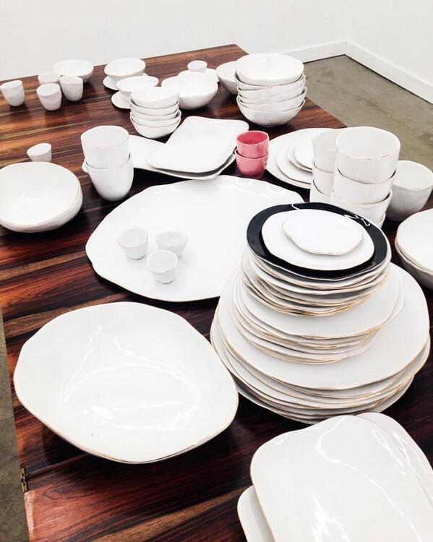
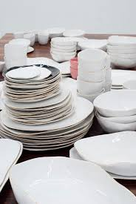
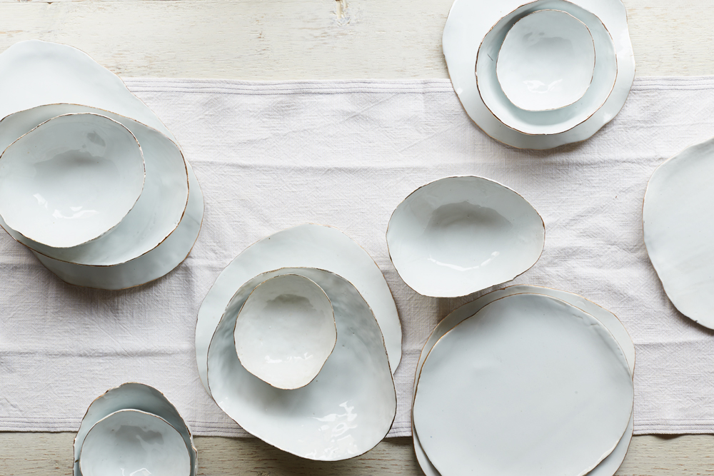
In a society that is sold visions of perfect meals in pristine rooms, Laura Letinsky’s photographs open one’s eyes to the aftermath of such perfection: tabletops in disarray, leftover dishes, squeezed lemons.
Letinsky, said her work is a way of looking at and thinking about what our lives are made of. “I’m interested in the home, the way that the domestic space is constructed or made-up. I manipulate photographic space to comment on the made-up-ness of home. The home is supposed to be a deliberate expression of who you are, but it always reflects decisions you make unconsciously as well as consciously: the colour of soap you choose, a plate from a previous marriage, a glass from Ikea.”
In her photographs, table edges end in black space, tablecloths do not give quite enough visual information to tell if they are being presented horizontally or diagonally: is that cup going to fall off? “I try and set up these spaces so the sense of gravity is ambiguous—there’s not one sense of which way down is because gravity is not operating consistently across the photograph. The viewer realizes the plasticity of photographic space and the relativity of one’s point of view.”
“Home seems a normal place, but look at all the work that goes into it. It’s not a natural space. I’m interested in that paradox about this home that’s supposedly organic and natural, that ‘just happens’ to be there, as opposed to all the work that goes into sustaining that idea in reality.”

Slide 18
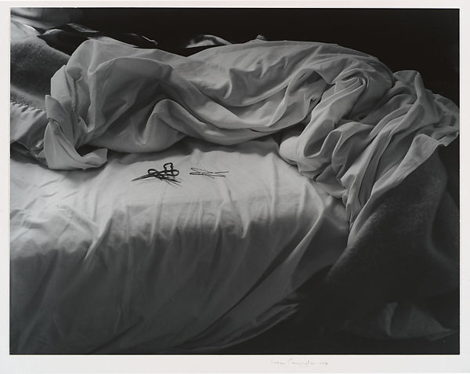
Imogen Cunningham

Slide 19
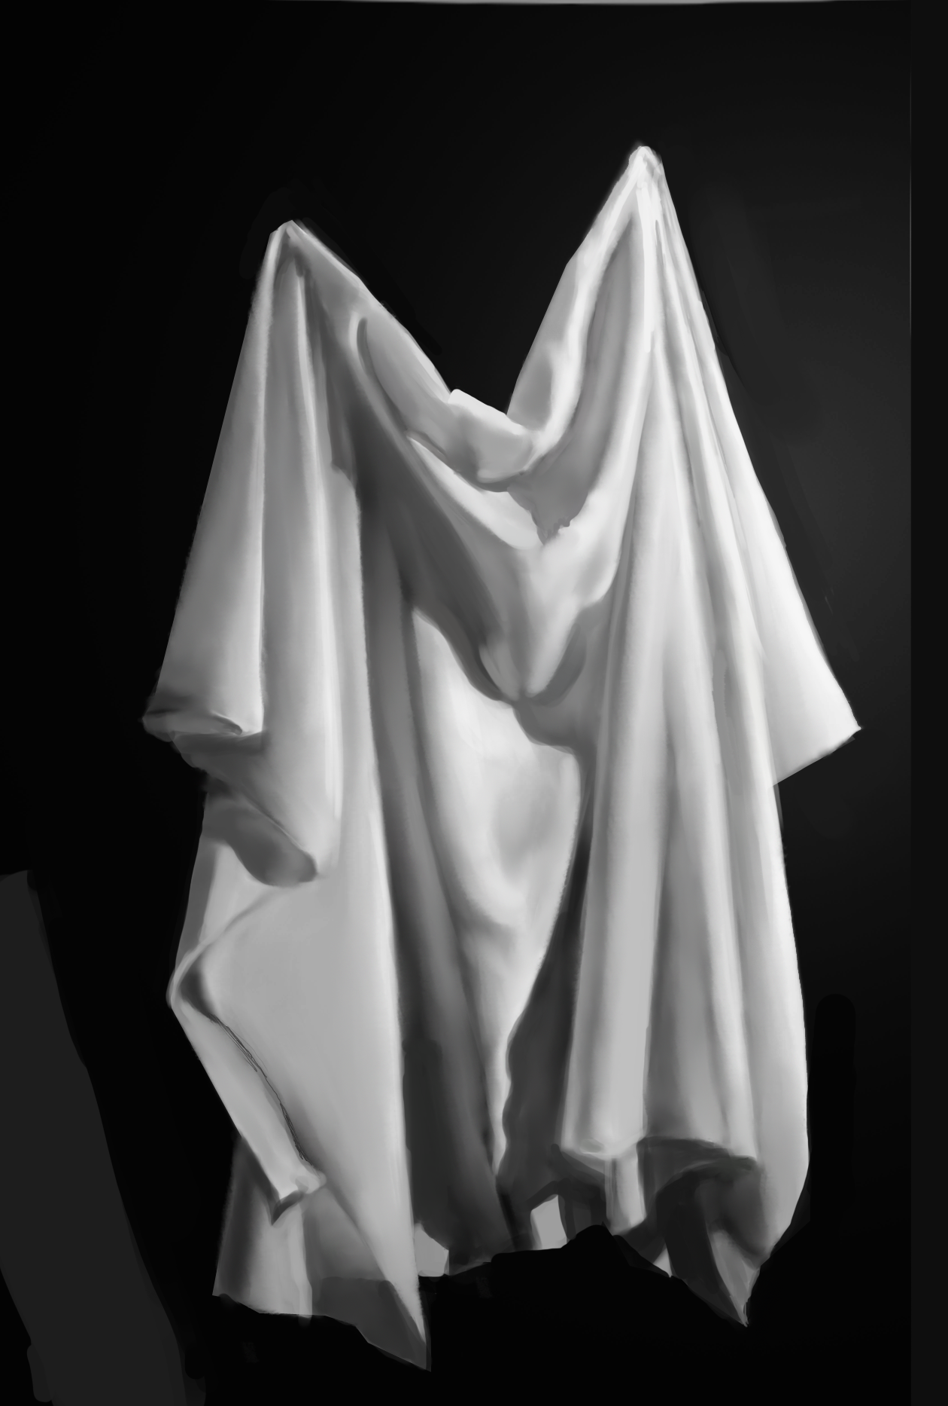
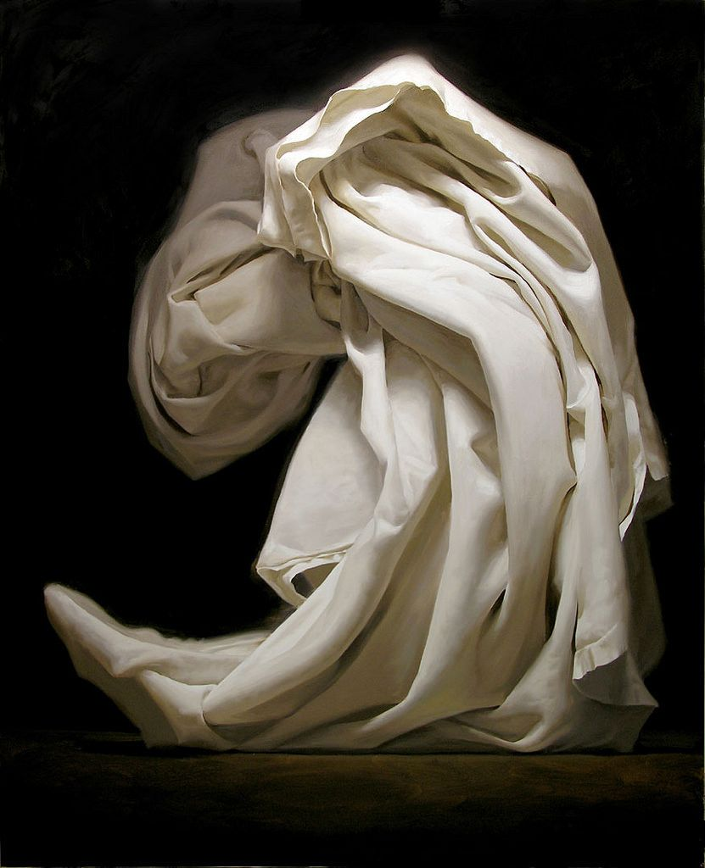
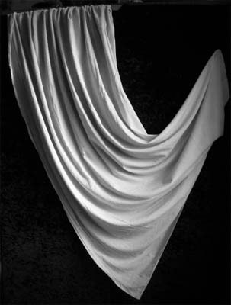
Drapery; towels, sheets, shirts.
Anonymous photos

Slide 20
Alexandr Rodchenko
Russian Constructivist Photography
In the mid-1920s Rodchenko turned to other mediums, most notably, photography. On a trip to Paris in 1925 he bought a handheld camera, which allowed him to easily experiment with the composition of images. He framed the world from new points of view—from above, below, and at other unexpected, sharp angles—encouraging the viewer to see familiar things in new ways.
In the early 1930s he embraced photography as a tool for social commentary, critically depicting the disparity between the idealized and lived Soviet experience. The images he made contrasted with Socialist Realism, which was declared the official style of art in the Soviet Union in 1934.

Slide 22
Objects
And
Still Life

Slide 23
Huang Xu
Huang Xu elevates this detritus to inspirational heights. Far from resembling waste, his densely textured, luminous prints suggest the fine silk textiles of Imperial China, evoking an age of decadence and wealth, recalling the historic trade links between China and the West. These histories ironically foreshadow the current balance of economic power, and give a wry commentary on the trade in materials; whilst China once shipped silk to the West, the West now ships used plastic bags back to China.

Slide 24
Naomi White “Plastic Currents” 2011
“A current is a continuous, directed movement of water generated by the forces acting upon it, such as the gravitational pull of the sun and the moon. Interaction with other currents transforms a current's direction and strength. In Plastic Currents, the every day plastic bag is transformed by light, turned from something familiar into something strange. Undulating and fluid these forms transition from non-biodegradable, reviled plastic bags into seemingly organic forms, imitating the very nature they threaten.
Through explorations of the material I am interested in the way plastic responds to touch, its surface, its weight, how it clings to lighter elements like lint and dirt through static electricity, and the way each bag is its own marvel. By isolating plastic bags, icons of waste and convenience, we are asked to consider our role in their affects, but also to question the transformative power of the photograph and its ability to reconcile a simple bag into something other worldly, full of possibilities.” naomiwhite.com

Slide 25
Edward Weston was a seminal American photographer whose radical approach to composition, lighting, and form changed the history of the medium. The photographs Shell (1927), and Pepper No. 30 (1930), evinces Weston’s ability to transform landscapes, portraits, and still lifes into visual enigmas.
“The camera should be used for a recording of life, for rendering the very substance and quintessence of the thing itself, whether it be polished steel or palpitating flesh,” the artist once stated. Born on March 24, 1886 in Highland Park, IL, he was given his first camera by his father at the age of 16, sparking a lifelong interest.

Slide 26
Edward Weston

Slide 27
Imogen Cunningham

Slide 28
After Russian Constructivism. Darek Grabus.
Through careful selection of objects and backgrounds, Explore pattern, composition, shadows and tone to create bold and striking images.

Slide 29
Shana Novak. Commercial Photographer

Slide 31
Weeks 5 & 6 Artist research, written interpretation of their work and creative response. Choose two of the artist’s whose work you find most interesting from this ppt; both in terms of how it looks and what it is about. For each artist, carry out contextual research about who they are/were, where and when they lived and what are/were the main influences on their work. You should present each artist across 2 A4 slides or a double page, whether in your sketchbook or powerpoint slides. Include an overview of imagery of their work ( 3 images) and in depth analysis of one piece. Use the guidance Interpreting Others’ Work to help with the research and writing. The 2nd double page or more should be your own, best creative interpretation of their work. Not a copy, but your interpretation of their ideas and techniques. If this is photographic you can present this on powerpoint if you don’t have a printer.

Slide 32
Draw, paint and photograph everyone in your house, document how everyone is spending their time.
Hope Gangloff

Slide 33
Leslie Graff
“I am fascinated by personal narratives, the stories of our lives. I believe everyone not only has a unique story, but also has specific talents and abilities and wisdom cumulated from their personal experiences. Each day we interact in relationships, those influences continually change us and evolve us.
I draw inspiration from art nouveau and midcentury periodical illustration.”
Explore the idea of how domestic life was seen in the 1940’s and 50’s and think of how things have changed today. How could you explore this through any appropriate media?

Slide 34
Linnea Strid
Draw, photograph and paint yourself and family members doing every day things, drinking, eating, washing, brushing your teeth etc….

Slide 35
Everyday Routines
Heikki Leis

Slide 36
Pierre Bonnard (French: 3 October 1867 – 23 January 1947) was a French painter, illustrator, and printmaker, known especially for the stylized decorative qualities of his paintings and his bold use of colour He was a founding member of the Post-Impressionist group of avant-garde painters Les Nabis, and his early work was strongly influenced by the work of Paul Gauguin, and the prints of Hokusai and other Japanese artists. He was a leading figure in the transition from impressionism to modernism. He painted landscapes, urban scenes, portraits and intimate domestic scenes, where the backgrounds, colors and painting style usually took precedence over the subject.
Pierre Bonnard

Slide 37
David Hockney

Slide 38
Pop Art interiors
Patrick Caulfield (British, 1936–2005)

Slide 39
Johannes Vermeer Genre paintings of everyday domestic life.

Slide 40
Njideka Akunyili Crosby

Slide 41
Richard Hamilton (1922-2011)
Create your own domestic interiors through collage.

Slide 42
Mary Casatt

Slide 43
Dod Proctor
Think about exploring people reading, sleeping, thinking, being bored. Think about the impact of light on an image.

Slide 44
“The series Broken houses is based on photographs of abandoned structures neglected by man and destroyed by the weather. I found these photos on the Flickr website while pursuing an amateur photographer from North Dakota who obsessively documented the decaying process of these houses. I used these printed photographs to create small-scale models. I photographed the models in a studio setting against gray background, isolating them from their environment.”
Ofra Lapid

Slide 45
Rachel Whiteread

Slide 46
Weeks 7 & 8
Assemblage and collections challenge
Over four double pages explore the theme of assemblage and collections, use the artists listed to help you with a starting point. You will need to research their work in order to decide how you will explore the theme. Include research into one Artist (your inspiration) over the 4 double pages.
You are also welcome to find your own artists as inspiration.
You can respond to this starting point using any medium or materials you would like but you must include drawing or painting somewhere over the four doubles.

Slide 47
Fernandez Arman 1928- 2005 French-American
Collections

Slide 48
Lisa Milroy Canadian. Born 1959

Slide 49
Andrea Tese
Clothing, bottles, appliances – relatable objects that serve as the basic accessories of daily life, schematically arranged to form a visual inventory of one man’s possessions. The Inheritance project is a deeply personal one for Andrea Tese. The photographs document the artist’s mourning process following the passing of her grandfather, rearranging the objects that filled his home into pictorial compositions to assert her own presence as an artist, while chronicling his life through a parading plethora of simple objects, ranging from those unique to the individual subject such as a collection of paperweights or newspaper clippings including those about Tese herself as a child, to pedestrian objects such as shoes or pots and pans.

Slide 50
Over a three-year period, Michael Landy made an inventory of over 7000 items that he owned, which he subsequently destroyed at a London- based department store in February 2001.
https://www.artangel.org.uk/project/break-down/

Slide 51
Tony Cragg, British, born 1949

Slide 52
Joseph Cornell American. 1903 – 1972 Collections- Boxed assemblages made from found objects

Slide 53
Assemblages from found objects by artists on Pinterest – make your own weird and wonderful creations from what you can find around your home and/or garden and draw from it.

Slide 54
Weeks 9-14
Project Development and resolved piece
Over a minimum of 6 double pages continue to explore the theme of home. This could be to continue with something you have already explored within the project or it could be to start something new.
There is an extensive list of artists on the title page of the power point to help you with this part of the project but you can always find your own artists if you have a specific idea.
Be experimental, show your planning, include artist research drawing and painting, practises of your resolved piece or pieces as well as evaluations of your work throughout.
We can’t wait to see what you will come up with.
All work is due in the first lesson back in September where you will be expected to present a powerpoint presentation of your work to the class.
This must be emailed to pprince@gch,org.uk before your first lesson.

